Slide 1

Machine learning techniques applied to damaged building detection in Panama City, FL, USA after Hurricane Michael (2018)
GEOG 761 / ENVSCI 707
Kaya Hollands | Sebastian Manning | Aqeel Munif |
Kate Ploeg | Meegan Soulsby | Kareen Urrutia
09-Oct-2023

Slide 2
1. Objective
To identify damaged buildings for rapid-post disaster response, damage assessment, and humanitarian relief after Hurricane Michael hit Panama City, Florida, USA on 10th – 12th of October 2018.
1.1. Research Questions
How can we use multispectral airborne imagery & machine learning techniques to identify damaged buildings in areas affected by Hurricane Michael?
How adaptable are CNN models for use in building damage assessment on new disaster types using different imagery?

Slide 3
1.2. Overview of our project
Evaluating accuracy
Recording learnings
Xview2 Challenge
Site
Selection
Adapting CNN model script (Yuhhuang, 2020)
A/B testing
Notes:
Xview2 Challenge and dataset.
Site selection for new test case (data availability/suitability).
Adapting the CNN model script (Yuhhuang, 2020).
A/B testing hyperparameters of the model.
Evaluating model accuracy.
Recording next steps and learnings.

Slide 4
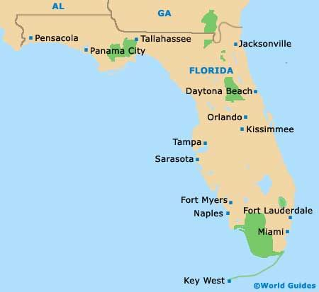
2. Local context
Panama City, FL, USA¹⁻²
Hurricane Michael (2018)³⁻⁴
Population: 49,975 (year 2017)
Area: 140.9 km²
Pop density: 354.6/km²
Category 5 (wind speeds > 249 km/h).
57 deaths
c.50,000 structures damaged, with about 3,000 destroyed in 4 FL counties
Over US$ 25 Billion in Damages
Source of image: https://www.pinterest.nz/pin/489766528206106469/

Slide 5
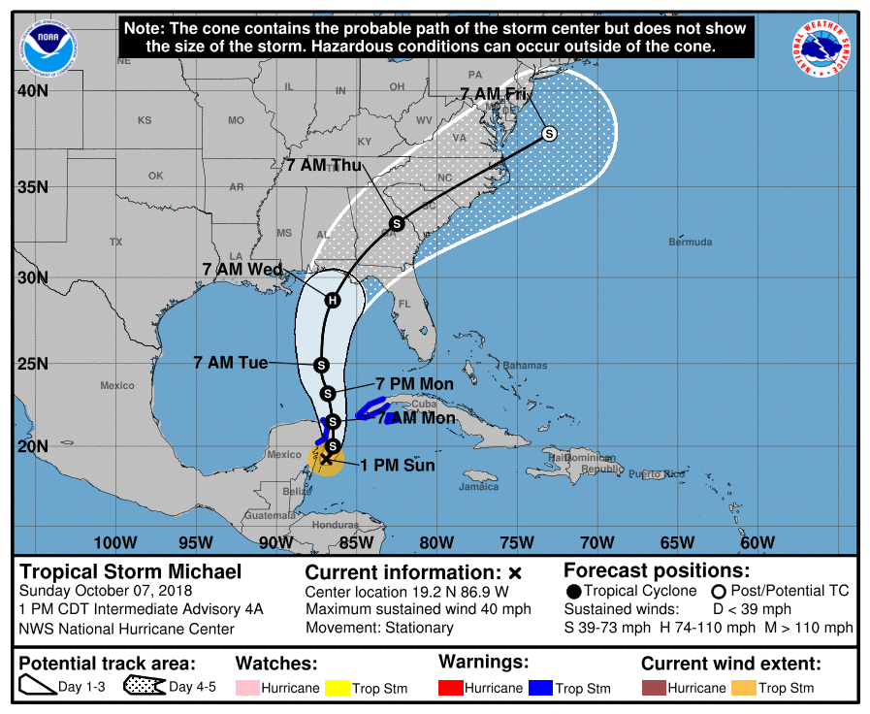
10th – 12th Oct. 2018
Made landfall on Mexico Beach and went northeast across Florida’s Panhandle
https://www.weather.gov/tae/HurricaneMichael2018

Slide 6
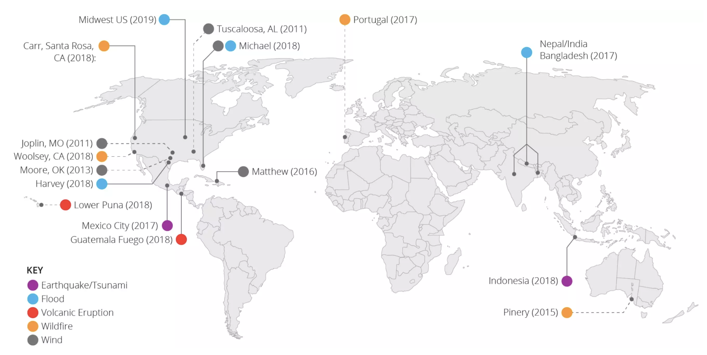
3. Input data: xBD and xView2
Reference research: Gupta et al. (2019)⁵
Building damage assessment for different disaster types
xBD and xView2 Challenge
MAXAR Imagery: WorldView series and GeoEye1
Resolution: 0.3 - 0.5 m, revisit daily

Slide 7
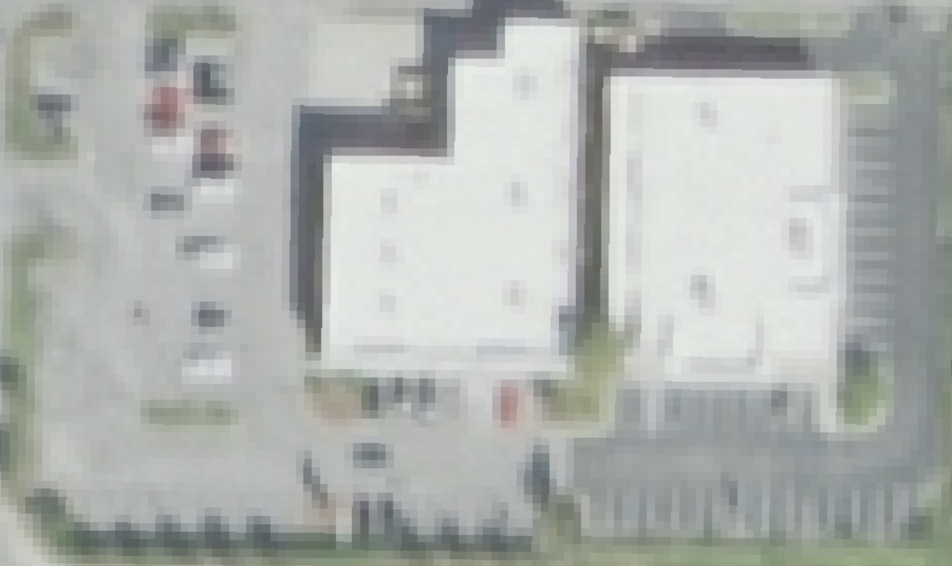
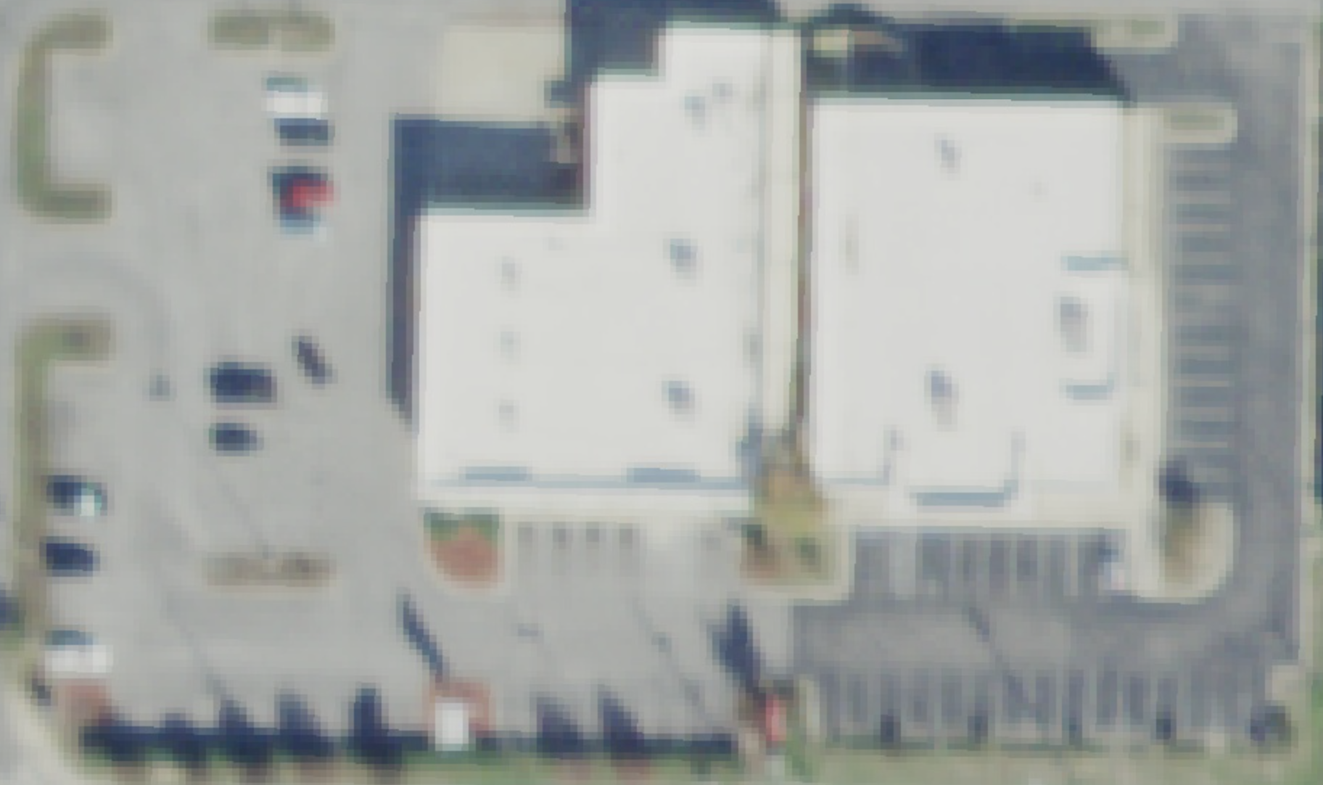
3.1 Input data: Code and NAIP
Before event: 1m
Code: Yuhan Huang (‘yuhhuang’ GitHub)⁶
Building damage assessment: Santa Rosa wildfire
xView2 annotations, NAIP imagery
Imagery: NAIP (National Agriculture Imagery Program)
GEE from 2003-present
Airborne
Older images: 3 bands (RGB)
Recent imagery: Addition of near-infrared band (RGBN)
Resolution: 1 m (2007-2017), and 0.6m (2019-2023), 3-year temporal
After event: 0.6m

Slide 8
4. Methodology
Selection of event and RQ
Data Pre-processing
Feature calculation
Convolutional Neural Network Training
Unsupervised clustering features
Convolutional Neural Network Testing
Image Extraction
Report Results
xView2 Challenge
Visualize Data
Model Set up
Model Use
Notes:
Initially, our focus was placed on working out the details of the xView2 challenge and how Yuhan Huang's code resources were able to tackle this
We could then choose a particular disaster event to center our work around
This was done by preprocessing the data for earthquakes, hurricanes and floods, as we suspected these to have the most devastating effects on buildings
We were then able to generate plots and start looking at the geography of the buildings that had faced damages from the events
Once we decided on a disaster and relevant location, known to be hurricane michael, we took the images before and after the disaster and went on to use it for the model
The original script was used to detect damages from wildfires, our theory is that this could be adapted to work for other types of disasters
The model used was a convolutional neural network – a form of supervised learning well-fit for this particular problem

Slide 9
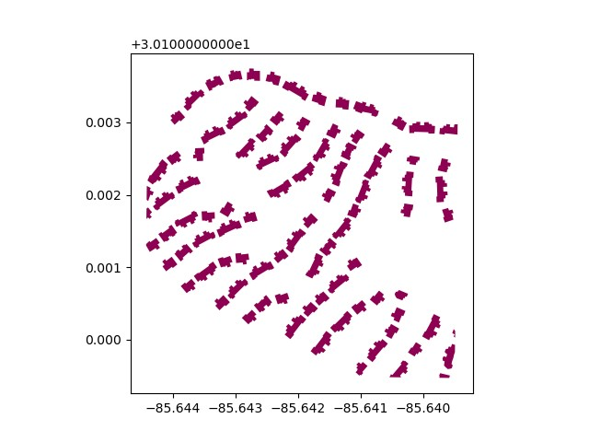
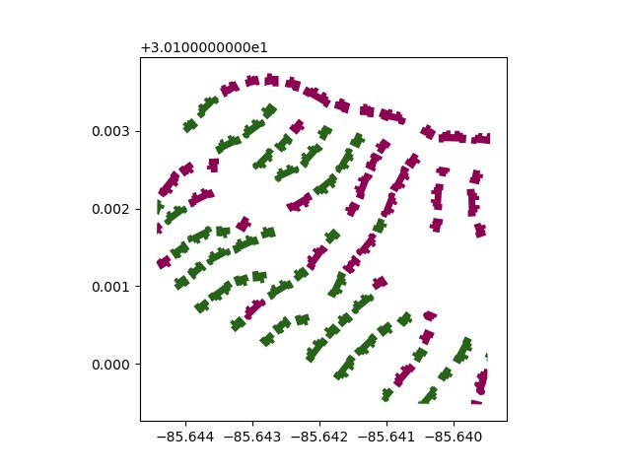
4.1. Data Preprocessing
xBD Disasters of Interest:
Hurricanes
Hurricane Florence
Hurricane Harvey
Hurricane Michael
Floods
Midwest Flooding
Earthquakes
Mexico Earthquake
Building Polygons
Pre-Disaster
Post Disaster
Notes:
The xBD data holds the JSONs encoding the buildings as polygons
Stores a single image taken as a tile that has , containing many buildings/polygons
Does this for every disaster, stores before and after disaster
We chose disasters that we thought to highly damage buildings and localised to this to North America, such that we can use NAIP images
Tags each building with the level of damage that occurred
Example of polygons, tagged with level of damage in post disaster, hence some green polygons
Made a shapefile for all the buildings involved for a particular disaster

Slide 10
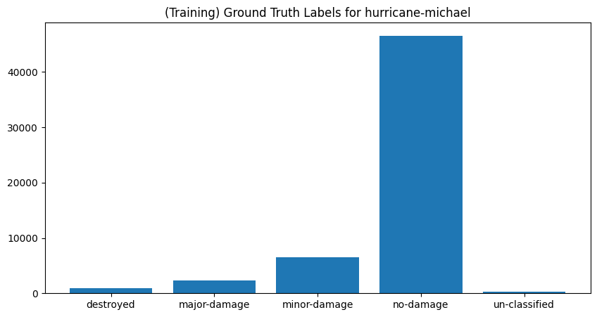
4.2. Damage Classification
Damage | # Buildings | % Buildings
Destroyed | 940 | 2%
Major-damage | 2311 | 4%
Minor-damage | 6570 | 11%
No-damage | 46,578 | 82%
Un-classified | 287 | 1%
Total | 56,686 | 100%
Notes:
A key factor that went into deciding what disaster and location we wanted to centre our project around was the level of damage incurred by the disaster itself
In data, damage faced by buildings was categorised into 5 levels: un-classified, no-damage, minor, major and destroyed
Our aim was to be able to develop the tool to be able to recognise where damage is prevalent
As such, we needed to see that the disaster we trained the model had varying levels of damage in buildings such that the model could learn from a wide set of data
Hurricane Michael was chosen as it gave the widest distribution of different damage levels for data we could have available to us

Slide 11
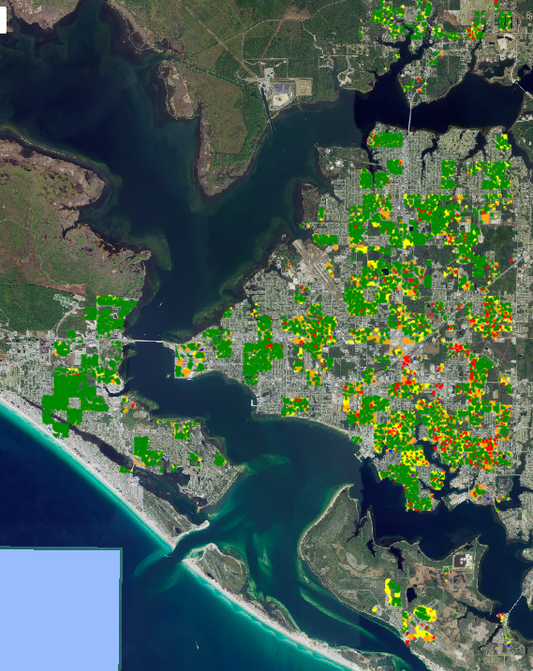
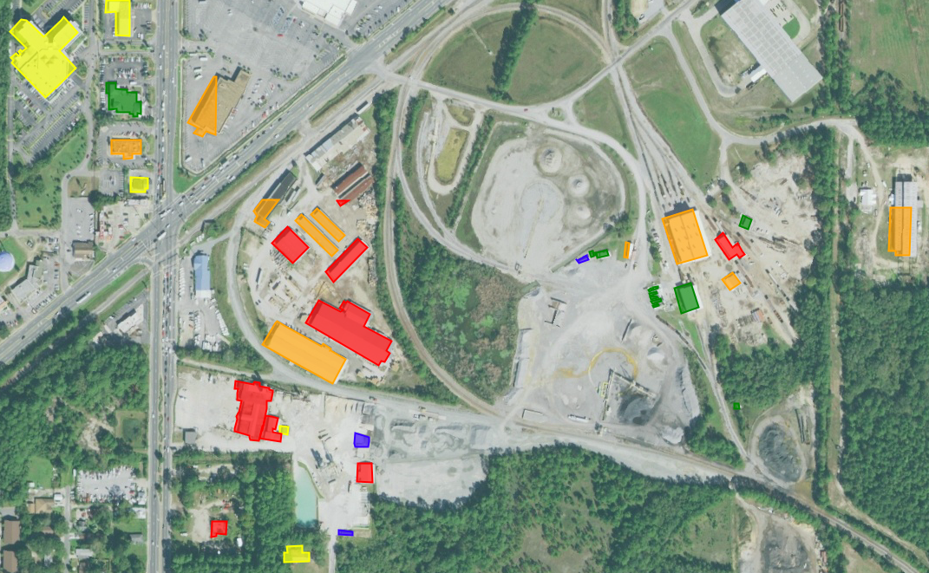
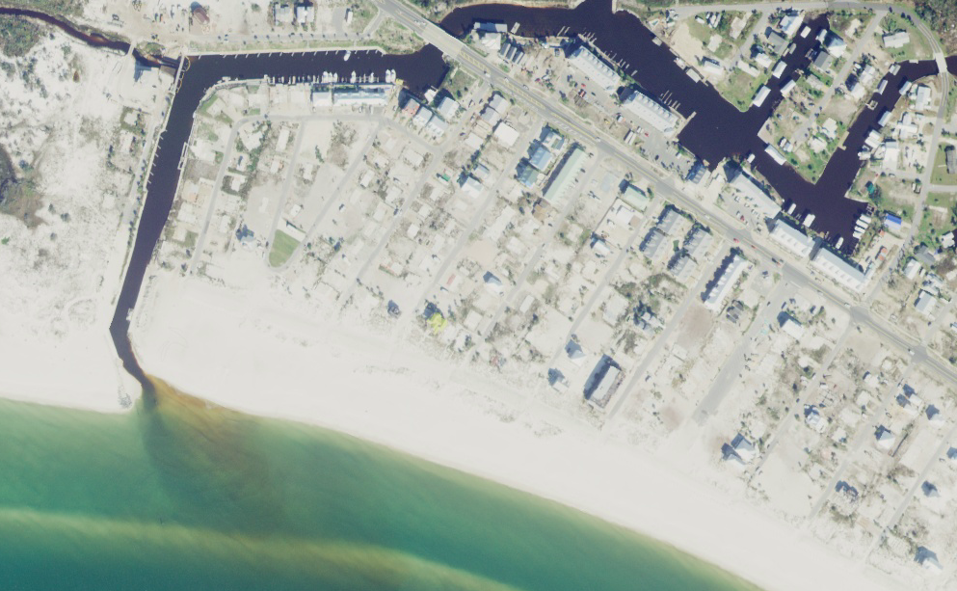
4.3. Damage Visualisation
Panama City, FL, USA
(classified polygons)
Key
Colour | Damage Classification
 | Un-classified
 | No-damage
 | Minor-damage
 | Major-damage
 | Destroyed
Mexico Beach, FL, USA (polygons not available)
Notes:
Part of the exploratory data analysis stage involved visualising the building polygons
We are able to see a large part of the city being involved in the dataset
We were also able to identify aspects of the different classifications and see where these were present
This helped us understand the dataset more and the context of the effects of the hurricane

Slide 12
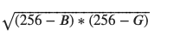
4.4. Feature Classification Metrics
Features | Description | Calculation Methods
Image | Imagery collected for tiles, Pre-Disaster: 2017-01-01 to 2018-10-01, Post-Disaster: 2018-10-31 to 2019-12-31, Bands: R, G, B, NIR | -
Normalized Difference Vegetation Index | Used to quantify health and density of vegetation | (NIR - R) / (NIR + R)
Bare Soil Index | Critical index for avoiding misclassification of bare soil as buildings | (R+B-G)/(R+G+B)
Shadow Index | Avoid missing data due to buildings’ shadows by removing them
Edge Detection | To extract structural information of edges | ee.Algorithms.CannyEdgeDetector(image, threshold, sigma for gaussian filter)
Texture Metrics | Measure the spatial association of the neighborhood b Calculate the gray-level co-occurrence matrix (GLCM) | Functions ee.Kernel.square followed by entropy GLCM required: contrast, correlation, variance, spread-out the grayscale-inverse difference moment (homogeneity), dissimilarity, cluster shade.
Notes:
After the appropriate disaster was selected, we could use google earth engine to load in images that corresponded to each tile, this involved getting the RGB and Near Infrared bands
These bands could be used as a starting point to start determining features that could be used to aid in the detection of buildings and building damage
Some of these are remote sensing indices to identify things like vegetation, bare soil and shadows, so as to not confuse these for buildings
More things like an edge feature to pick up building edges
Something to understand the differentiation of the terrain within a localised area/neighbourhood through a number of texture metrics e.g., contrast, shade

Slide 13
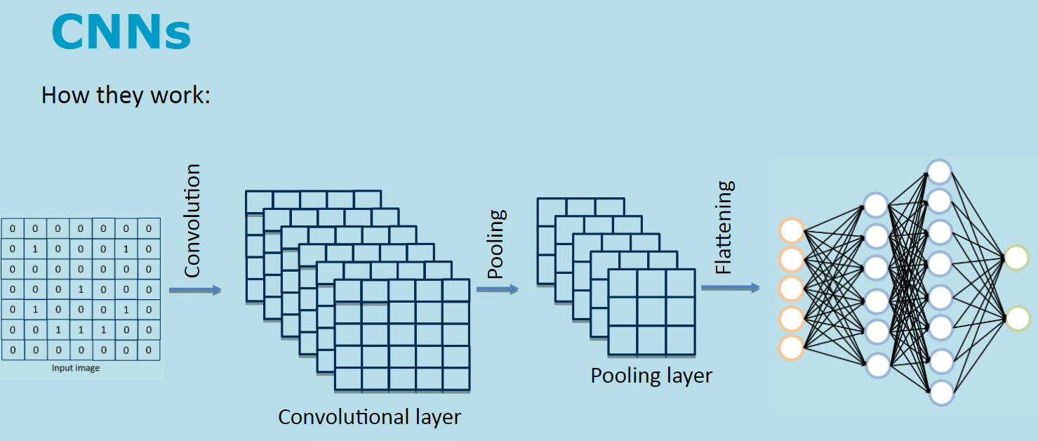
4.5. Convolutional Neural Network
Notes:
The main ML model is a convolutional neural network
Its main use case is to use various layers to understand and predict on the features of input data
There are convolutional layers: Pass a filter/kernel over the data to detect features
Pooling layers: reduce spatial dimensions to summarise blocks of pixels with a singular pixel
Then leads into fully connected layers that do more high-level identification of features and decision-making
Ultimately allows for the prediction of features within the image
This works well for grid-like topology as the input, therefore good for images

Slide 14
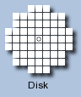
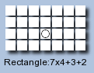

4.6. Convolutional filters for layers
Convolutional Filters for Layers | Description | Method
Low-pass Filter (Gaussian) | Smoothing and reducing of noise | ee.Kernel.gaussian
Shaped Kernel (Rectangle, Octagon) | Uses a shaped kernel to adapt to the regular shapes of buildings | ee.Kernel.rectangle ee.Kernel.octagon
Manhattan Distance Filter | Picks up on clear horizontal and vertical elements | ee.Kernel.Manhattan
Octagon kernel
Rectangular kernel
Manhattan distance kernel
Notes:
More on convolutional filters
The filters that pass through the image in order to pick up on features
We apply Gaussian, Rectangular and Manhattan filters to the image
The gaussian filter is able to smooth out the features of the image and reduce the amount of noise
There are shaped filters/kernels that can help pick up on the relatively regular shapes laid out by the edges of buildings
The Manhattan distance filter which is able to pick up on long unidirectional lines, i.e., edges of buildings
These are calculated for the image and added as features
Sources (to read more):
Google Earth Engine documents - Developers
https://imagemagick.org/Usage/morphology/#manhattan

Slide 15
4.7. Train/Validate/Test Split
Dataset | Description | Percentage of Overall Dataset
Train | Data used to train the model | 72%
Validate | A sample of data held back from the train data to estimate model skill and tune hyperparameters | 18%
Test | Data used to give an unbiased estimate of the skill of the final tuned model | 10%
Total |  | 100%
Overall
100%
Train & Validate
90%
Train
72%
80%
90%
20%
Validate
18%
10%
Test
10%
Test
10%
Notes:
When using the model, we split the dataset by the number of image tiles used for each purpose
We have a training set that is the majority of the data
A validation set, specifically taken from the training set to be held back and used to estimate the model skill and tune the hyperparameters
A test set, that is unseen to the model in the building and tuning stages, and is purely used to estimate the skill of the final model
The approach taken here was to take a 90% block of the data, and set aside 20% of that 90% to be validation data, leaving 72% of the overall dataset as pure training data, and 18% as validation data
This leaves the 10% of test data

Slide 16
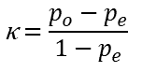
4.8. Accuracy Metrics: Cohen’s Kappa
Used to measure the degree of agreement/disagreement of two dependent samples
Function: metrics.cohen_kappa_score
Kappa | Description
Kappa < 0 | Agreement is worse than chance
Kappa = 0 | Agreement is no better than chance
0 < Kappa 0.2 | Slight agreement
0.2 ≤ Kappa < 0.4 | Fair agreement
0.4 ≤ Kappa < 0.6 | Moderate agreement
0.6 ≤ Kappa < 0.8 | Substantial agreement
0.8 ≤ Kappa < 1 | Almost perfect agreement
Kappa = 1 | Perfect agreement
Increasing Agreement
Probability of agreement between two raters (observed)
Hypothetical probability of a random agreement (expected)
Notes:
Once the model was trained on a collection of tiles, we test it
One of the accuracy measures we use for testing is Cohen's kappa
This measures the agreement of categorical classifications made by different raters/observers
Idea is that it can account for the possibility of agreement by chance
Why this is useful in GIS, can evaluate spatial agreement between patterns that are predicted and observed
Sources:
https://datatab.net/tutorial/cohens-kappa (very good video here)

Slide 17
4.9. Cloud Computing
Model is difficult to run on PCs
Large disk space required for storage of images
Processor/GPU insufficient for model building
Therefore, we use Google Cloud Platform
Cloud storage through buckets
VertexAI package
Machine learning resources
Virtual machines - 16 vCPUs, 104 GB RAM, 1 Tesla P4 GPU
Notes:
Running these scripts were initially done as Google Colab notebooks
This required us to run these on our own PCs
The issues associated with that is that it wasn’t reasonable to store the images on our own drives or personal cloud storage, as the TIF files could get quite large and there was a lot of them
The processors and GPUs that were being used for our PCs made it difficult or impossible to run the model
We rectify this using Google Cloud
One thing they have is buckets, allowed us to store large numbers of files through cloud storage
The other thing is the VertexAI package, specifically made for machine learning and AI applications
JupyterLabs and TensorFlow
We could run these scripts on virtual machines with much more powerful CPUs and GPUs and more memory

Slide 18
5. Results - Model
Conducted multiple tests with 20 tiles:
Native resolution – Post-event imagery at 0.6m
5 layers
2 layers
2 layers – low accuracy
Reduced resolution – Post-event imagery at 1m
2 layers

Slide 19
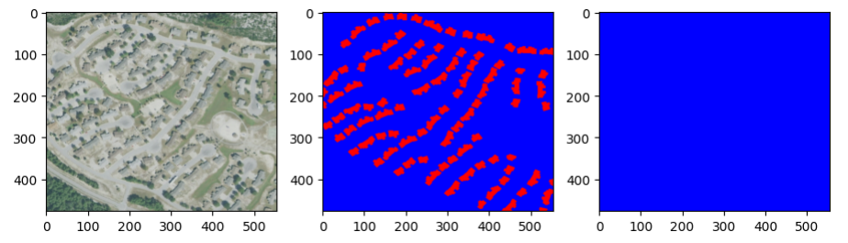
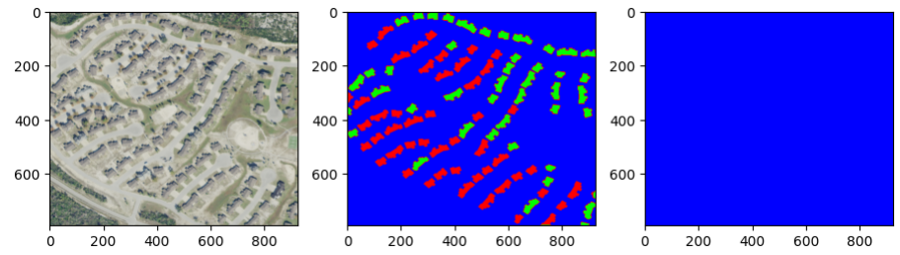
5.1. Results – 20 tiles – 5 Layers
Key
Colour | Damage Classification
 | No Building
 | Damaged Building
 | Undamaged Building
Photo Ground True Prediction
Pre-event
Post-event
Notes:
Explain 2 layers neural network
Explain 3 types of image.
Photo, Ground true, Prediction – add these as labels
Remember to explain what the colours mean

Slide 20
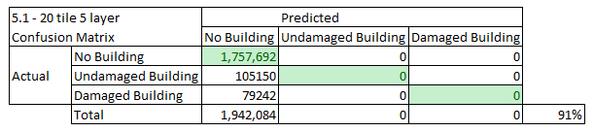
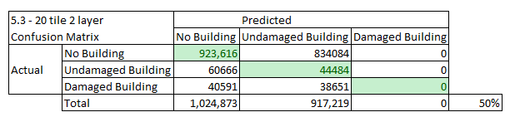
5.2. Confusion Matrix
Notes:
Get rid of excel lines

Slide 21
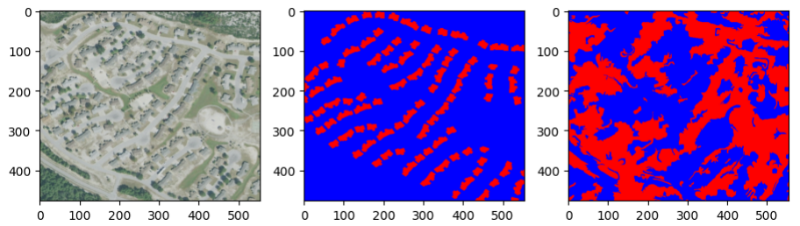
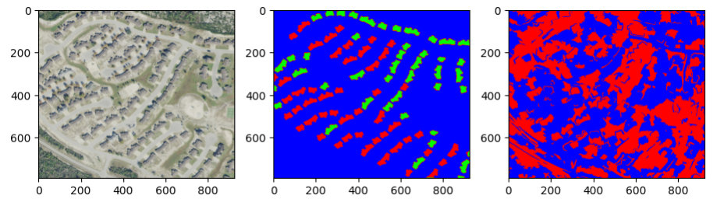
5.3. Results – 20 tiles – 2 Layers
Key
Colour | Damage Classification
 | No Building
 | Damaged Building
 | Undamaged Building
Photo Ground True Prediction
Pre-event
Post-event
Notes:
Explain 2 layers neural network
Explain 3 types of image.
Photo, Ground true, Prediction – add these as labels
Remember to explain what the colours mean

Slide 22
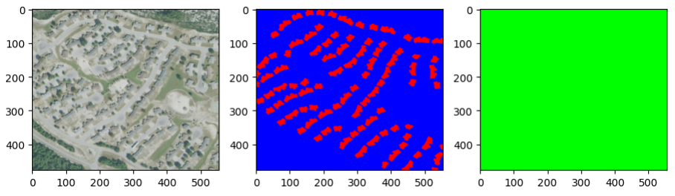
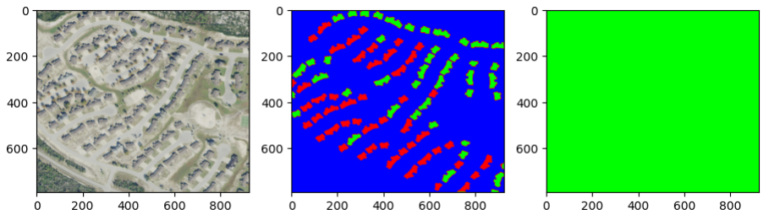
5.4. Results – 20 tiles – 2 Layers – Low Accuracy
Key
Colour | Damage Classification
 | No Building
 | Damaged Building
 | Undamaged Building
Photo Ground True Prediction
Pre-event
Post-event
Notes:
Explain 2 layers neural network
Explain 3 types of image.
Photo, Ground true, Prediction – add these as labels
Remember to explain what the colours mean

Slide 23
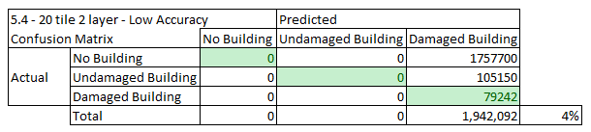
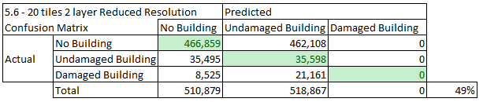
5.5. Confusion Matrix
Notes:
Get rid of excel lines

Slide 24
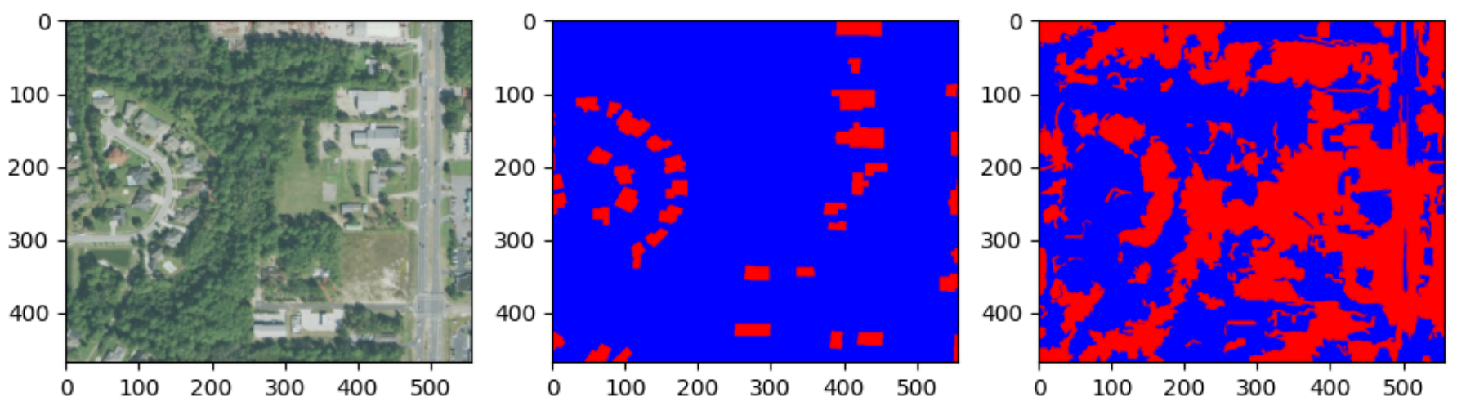
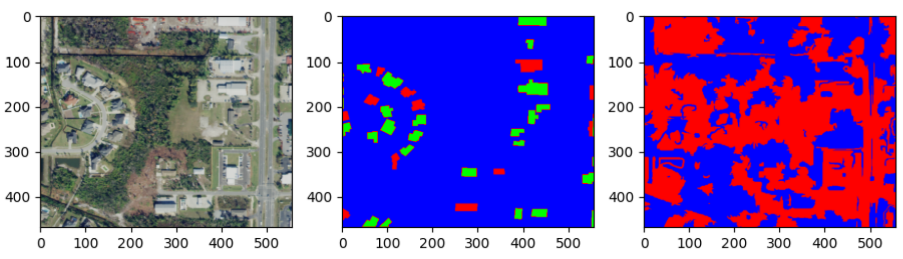
5.6. Results – 20 tiles – 2 Layers Reduced Resolution
Key
Colour | Damage Classification
 | No Building
 | Damaged Building
 | Undamaged Building
Photo Ground True Prediction
Pre-event
Kappa: 0.0091
Post-event
Kappa: 0.0117
Notes:
Due to the neutral network method we are using it is difficult to get the same result twice

Slide 25
6. Limitations #1
Difficult to find freely available high spatial and temporal resolution images, Google Cloud storage costs time and money
NAIP has a three-year cycle, and limited to only North America
NAIP images post-event taken a year and a half later – buildings were rebuilt or the area cleaned, difficult to see damage
Ground truth is not classified
Notes:
Explored different EQ events, require sufficiently dense population and high spat. res imagery
Sharing buckets
Companies have to spend money – must be targeted in what you do/run and spend.
Ground truth unclassified – couldn't tell hospital buildings etc., we relied heavily on building footprints with no architecture type etc.

Slide 26
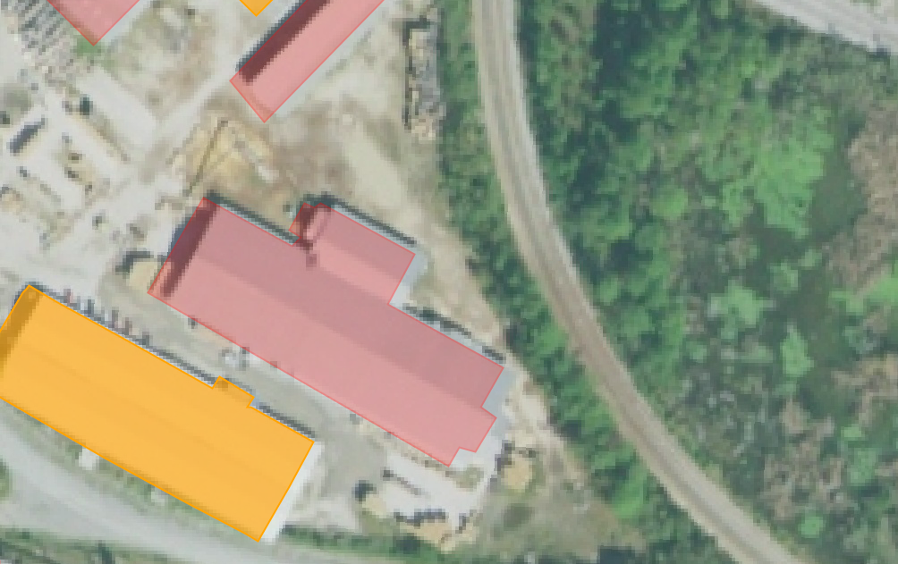
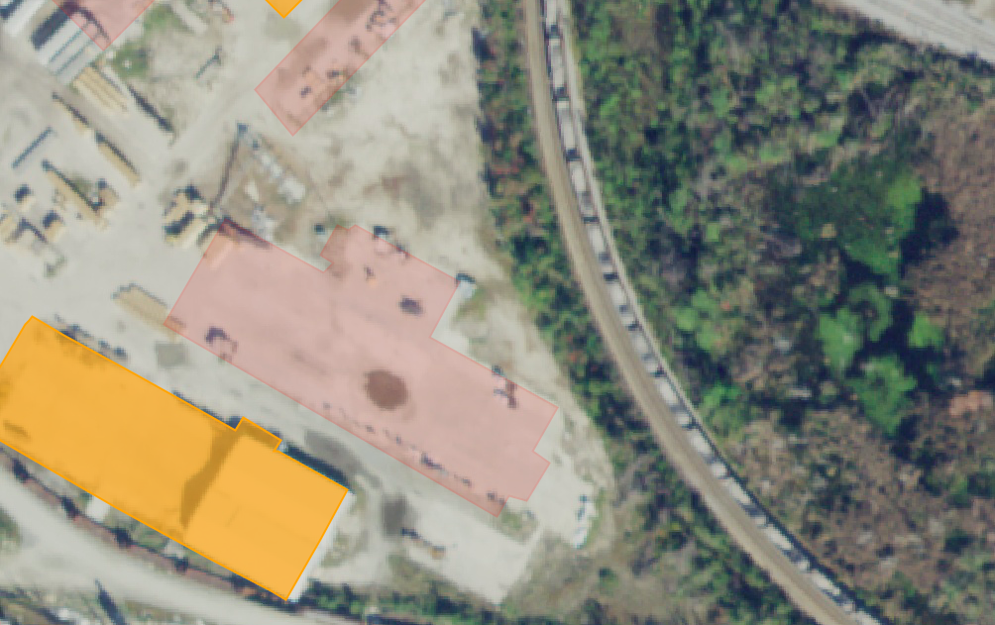
6. Limitations #2
The 2017 pre-disaster images had 1m resolution, but 2019 post-disaster images were 0.6m - needed to reduce the resolution
Our reduced resolution code slightly altered the building footprints
Model needs sufficient tile amount for a meaningful outcome, making process time consuming
Pre-event
Post-event
Notes:
Different resolutions meant we couldn't directly compare the pre- and post-disaster images for hurricane damage. Ideal world: same resolution, for comparisons.

Slide 27
7. Vision on next steps #1
Produce polygons with 'Segment Anything' Python notebook for other affected areas (Mexico Beach, FL, USA) that could be ground truthed
Look for damage within given building footprint polygon instead of whole area to give more meaningful accuracies
Could compare CNN results with classic ML methods like SVM and Random Forest
Notes:
Link to xView2 Challenge – apply ML to future disasters and areas
Support Vector Machine – supervised ML algorithm for classification and regression

Slide 28
7. Vision on next steps #2
Could expand CNN to post-disaster damage assessment of roads, bridges, buildings of interest, etc.
Train on the whole dataset, ~334 tiles of training data available
Try for a commercial dataset that is readily available with high temporal and spatial resolution, potentially geostationary orbit
Notes:
Has the potential to help in real world disaster recovery!

Slide 29








8. Communication of results
Share information in a file and format easy to transfer and interpret.
Existing protocols: National Emergency Communications Plan (NECP)⁸ and the National Disaster Recovery Framework (NDRF).⁹
Engage with key institutions and other relevant stakeholders (prior/after).
Notes:
Federal Emergency Management Agency (FEMA)
Department of Homeland Security (DHS)
National Coordinating Center for Communications (NCC)
Commission activated the Disaster Information Reporting System (DIRS)
Emergency Communications Division within the Cybersecurity and Infrastructure Security Agency (CISA)
National Oceanic and Atmospheric Administration (NOAA)
United States Geological Survey (USGS)
The National Emergency Communications Plan (NECP) is the nation’s strategic plan to strengthen and enhance emergency communications capabilities. The NECP was developed by CISA

Slide 30
9. Conclusions
Availability of high-resolution data is a key limitation for applying ML models in rapid disaster response planning.
CNN ML models can be adapted for different disaster types with significant ground truthing, preparation and testing.
Targeted disaster response contributes to efficiencies in rescue efforts post-disaster.
As ML models that used ground-truthed data sets evolve (i.e., xBD) it is hoped that models such as ours can be applied to new contexts without the need for training or ground truthing.

Slide 31
10. References
United States Census Bureau. (2022). City and Town Population Totals: 2010- 2019. Available from: https://www.census.gov/data/tables/time-series/demo/popest/2010s-total-cities-and-towns.html
United States Census Bureau. (n.d.) Quick facts. Available from: https://www.census.gov/quickfacts/fact/table/panamacitycityflorida,panamacitybeachcityflorida,ionacdpflorida/LND110220
FEMA. (2020). Mitigation Assessment Team Report. Hurricane Michael in Florida. Building Performance Observations, Recommendations, and Technical Guidance. FEMA P-2077.
NOAA (n.d.) Catastrophic Hurricane Michael Strikes Florida Panhandle October 10, 2018. Available from: https://www.weather.gov/tae/HurricaneMichael2018#:~:text=Michael%20made%20landfall%20along%20the,of%20919%20millibars%20(mb)%20
Gupta, R., et al. (2019). Creating xBD: A dataset for assessing building damage from satellite imagery. In Proceedings of the IEEE/CVF conference on computer vision and pattern recognition workshops (pp. 10-17).
Yuhan Huang. 2020. Building_Identification_Damage_Assessment. Available from: https://github.com/yuhhuang/Building_Identification_Damage_Assessment
XView2. (n.d.). Computer Vision for Building Damage Assessment. Available from: https://xview2.org/
FEMA. (2016). National Disaster Recovery Framework. Available from: https://www.fema.gov/sites/default/files/2020-06/national_disaster_recovery_framework_2nd.pdf
CISA. (2019). National Emergency Communications Plan. Available from: https://www.cisa.gov/sites/default/files/publications/19_0924_CISA_ECD-NECP-2019_1.pdf

Slide 32
Thank you!

